Slide 1
Project 2: Measuring Planet Mass, Radius, and Density for system GJ 436 b
M. Berger, A. Bernhardt, M. Bleich, Y. Shi, A. Tarrant

Slide 2
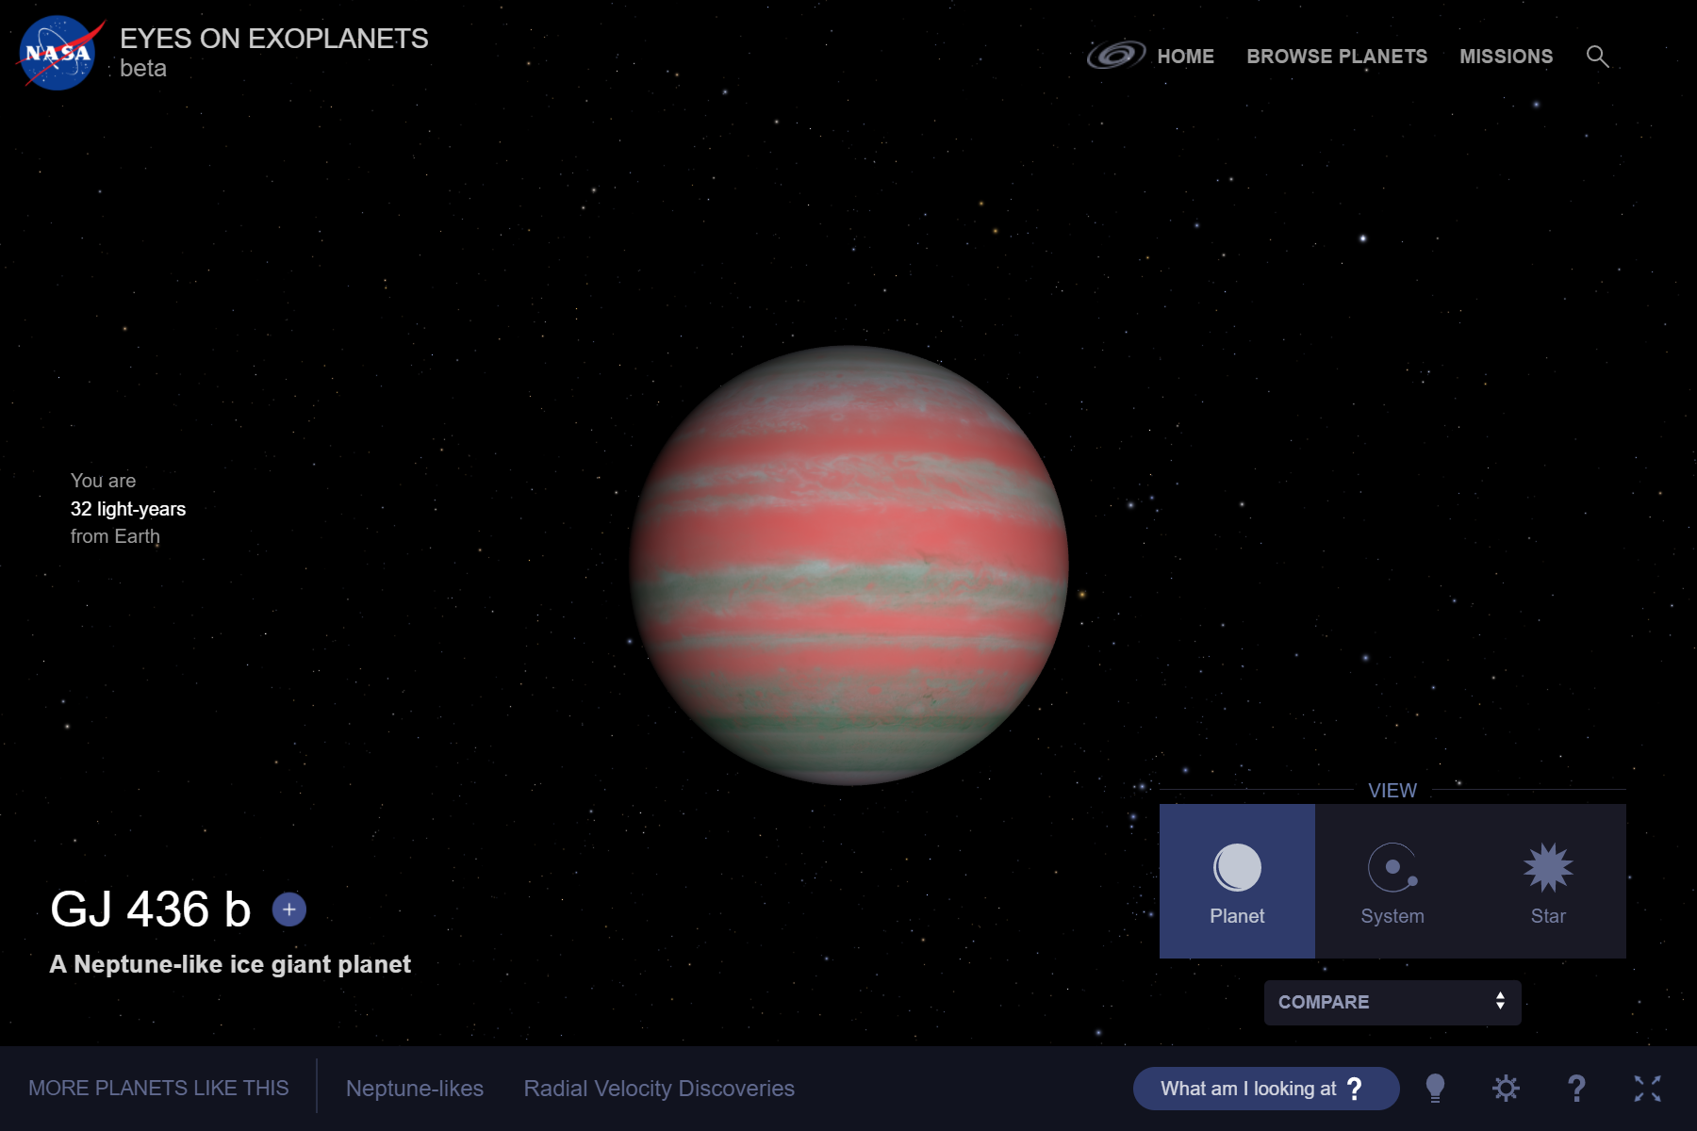
Introduction
Understand GJ 436 b properties
Measure mass (M)
Measure radius (R)
Calculate density (ρ)
Terrestrial/gaseous planet?
NASA

Slide 3
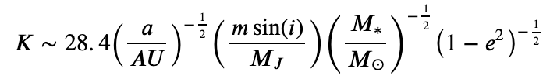
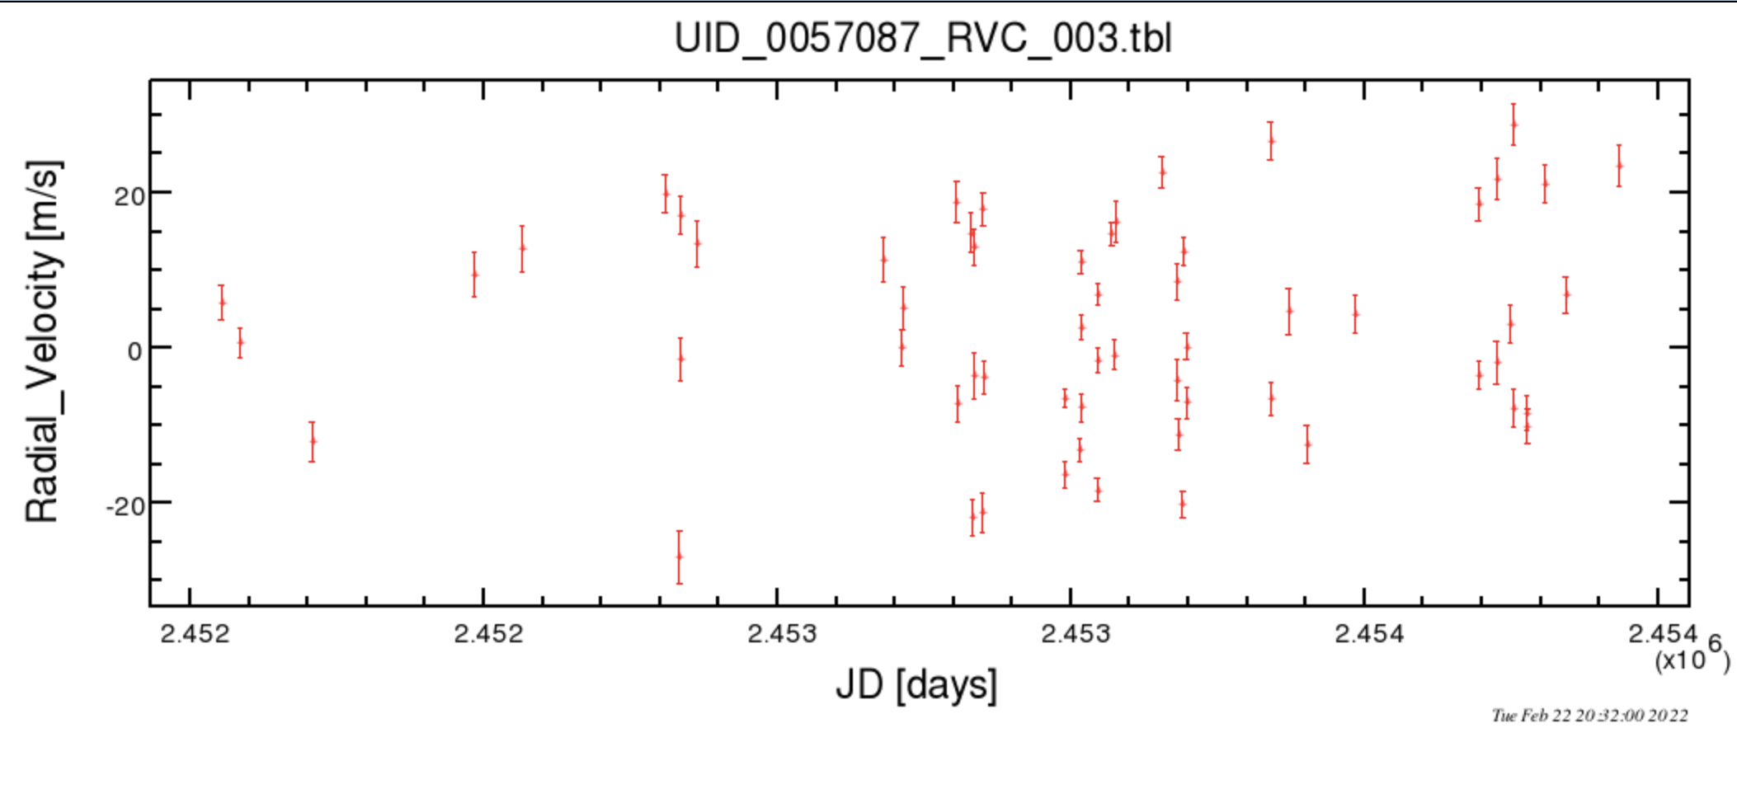
Methods - Planet mass based on radial velocity (RV) data
Need to find K_{Measured} from raw data
GJ 436 b has a semi-amplitude of K_{Actual} = 18.7 m/s
a = 0.0285 AU ​
e = 0.160​
M* = 0.452 M_{sun​}
i = 85.8°
​
​
Raw Radial Velocity Data (Maness et al., 2007)​

Slide 4
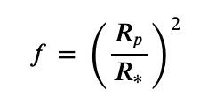
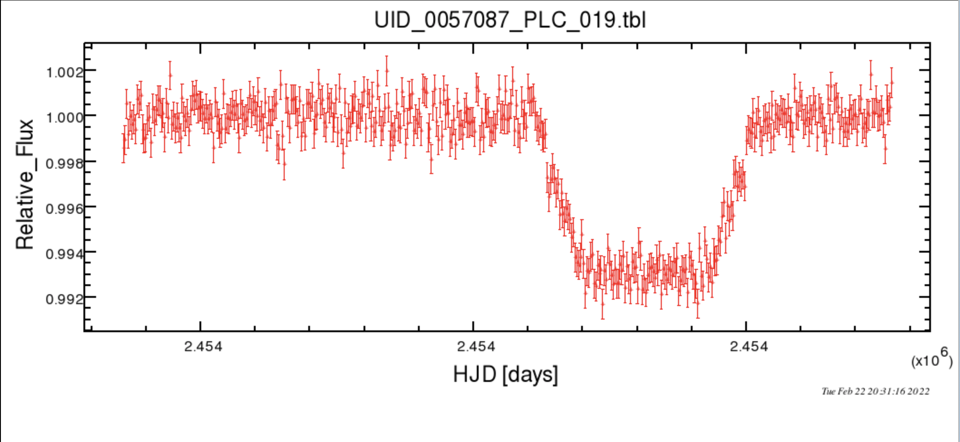
Methods - Planet radius based on transit data
Need to find measured depth from raw transit data
Use pylightcurve to plot
our model curve
R* = 0.464 R_{Sun}
Raw transit data (Deming et al., 2007)

Slide 5
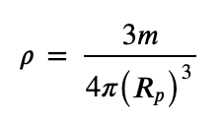
Methods - Planet density based on M & R measurements
Mass (M) - found from RV
Volume (V) - use radius (R) from transit
ρ= M / V
Spherical approximation

Slide 6
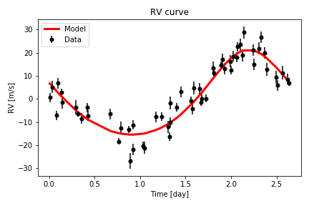
Results – Planet mass
K_{Measured} = 18.34 m/s
M_{P} = 23 ± 3 M_{E}
M_{actual} = 22.10 M_{E}
4% error

Slide 7
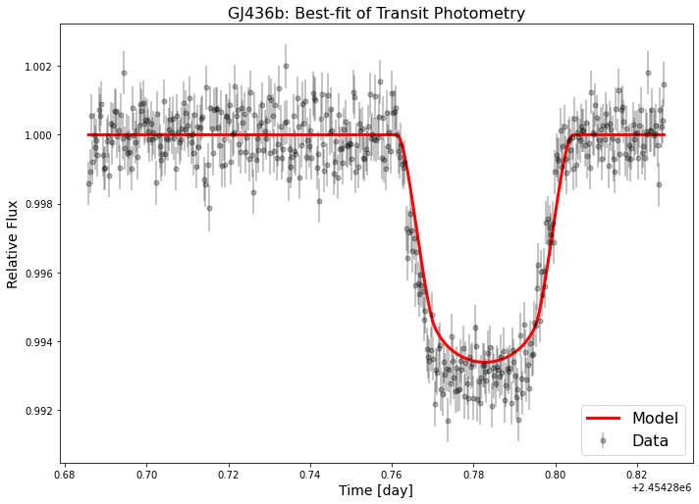
Results – Planet radius
f_{measured} = 0.00598
R = 3.52 ± 0.19 R_{Earth}
R_{actual} = 4.14 R_{Earth}
~ 15% error

Slide 8
Results – Planet density
Overestimate mass, underestimate radius → overestimated density
ρ = 2.9 ± 0.2 g/cm³
~1.60 times larger than actual density
Density of Earth: ρ = 5.51 g/cm³
Density of Neptune: ρ = 1.64 g/cm³

Slide 9
Results – Comparing GJ 436 b to Similar Exoplanets
Selected Exoplanet Measurement Range
- Mass: 15-30 M_{Earth}
- Radius: 2-5 R_{Earth}
Additional Data Set Information
- 32 Exoplanets emerged from measurement range
- All 32 of these planets were discovered via Transit Method
- Initial discovery of GJ 436 b found by RV Method

Slide 10
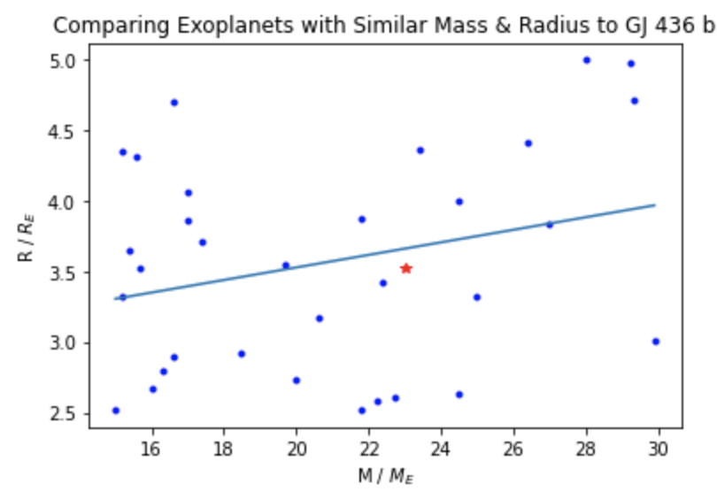
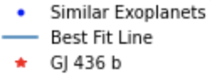
Results – Comparing GJ 436 b to similar planets
Observations:
Radius increases slightly with growing mass (best fit line)
Know this to be valid due to Chen & Kipping M-R Relation (2016)
GJ 436 b appears to follow this trend closely

Slide 11
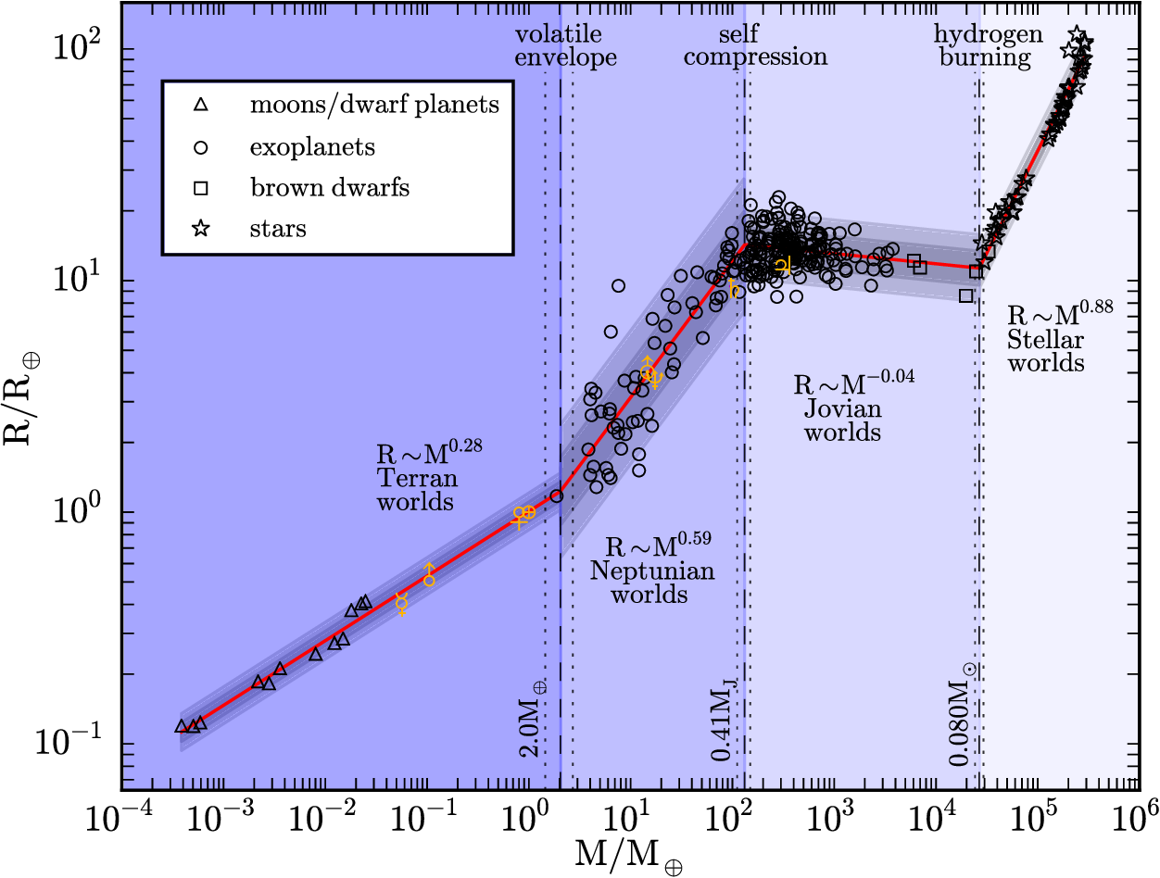
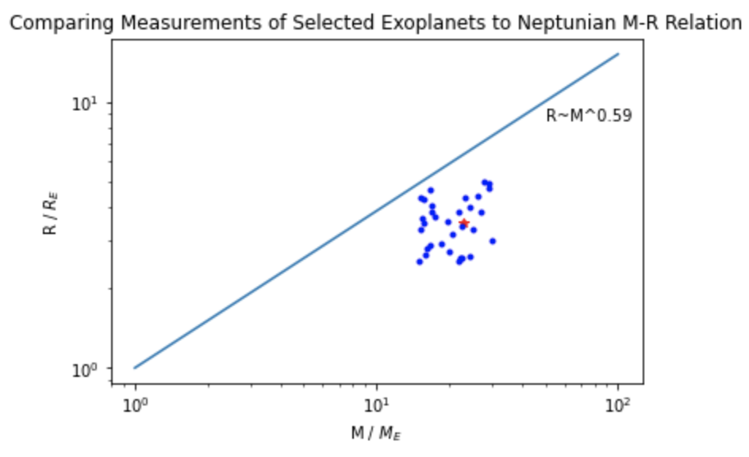
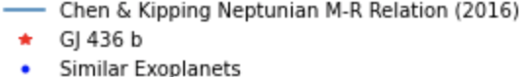
Chen & Kipping, 2016
For our mass (M = 23.00 M_{E}), C&K predicts a radius of R ≈ 6.36 R_{E}

Slide 12
Observations:
GJ 436 b & similar exoplanets (Neptune-like) deviate below the relation line
Could be due to specific measurement range
1640 exoplanets have been found in the range of 2-6 R_{Earth} (NEA)

Slide 13
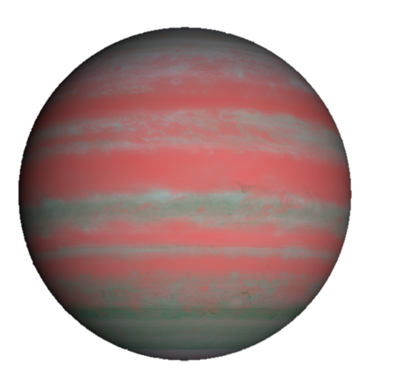
Conclusions
Measured mass, radius, and density of GJ 436 b were near the exact values
Measured properties followed the trend produced by exoplanets with similar mass and radius
This collection of exoplanets deviated below the Neptunian M-R relation
Due to low density, we'd expect GJ 436 b to have a gaseous atmosphere with a small rocky core
Modified from NASA

Slide 14
Contributions
Alex – Comparing GJ 436 b to similar exoplanets & M-R relation, ppt
Ashley – Report, calculations, ppt
Mariana – Report and ppt
Missie – Calculated radius
Yuanhao – Calculated mass

Slide 15
References
Chen, J., & Kipping, D. (2016). Probabilistic forecasting of the masses and radii of other worlds. The Astrophysical Journal, 834(1), 17.
Deming, D., Harrington, J., Laughlin, G., Seager, S., Navarro, S. B., Bowman, W. C., & Horning, K. (2007). Spitzer transit and secondary eclipse photometry of GJ 436b. The Astrophysical Journal, 667(2), L199.
Maness, H. L., Marcy, G. W., Ford, E. B., Hauschildt, P. H., Shreve, A. T., Basri, G. B., ... & Vogt, S. S. (2007). The M Dwarf GJ 436 and its Neptune‐Mass Planet. Publications of the Astronomical Society of the Pacific, 119(851), 90.
NAE. Counts by Radius 2 < R ≤ 6 R_Earth. Planetary systems. Retrieved February 23, 2022, from https://exoplanetarchive.ipac.caltech.edu/cgi-bin/TblView/nph-tblView?app=ExoTbls&config=PS&addcol=pl_rade&constraint=pl_rade+in+%282%2C6%5D
NASA. Exoplanet-catalog – exoplanet exploration: Planets beyond our solar system. NASA. Retrieved February 23, 2022, from https://exoplanets.nasa.gov/exoplanet-catalog/6534/gj-436-b/
Ucl-Exoplanets, A. (2021). UCL-exoplanets/pylightcurve: A python package for modeling and analysing transit light-curves. GitHub. Retrieved February 23, 2022, from https://github.com/ucl-exoplanets/pylightcurve

